Slide 1
Know graph identification
Peiqin Gu, Jan 6, 2014

Slide 2
Info
Knowledge Graph Identification. Jay Pujara, Hui Miao, Lise Getoor, William Cohen.
Conference: ISWC 2013
Affiliation
University of Maryland, CMU

Slide 3
Motivation
The web is a vast repository of knowledge, but automatically extracting that knowledge at scale has proven to be a formidable challenge.
This extracted knowledge has been referred to as a knowledge graph.
A key challenge in producing the knowledge graph is incorporating noisy information from different sources in a consistent manner.

Slide 4
Motivation
Information extraction systems operate over many source documents, such as web pages, and use a collection of strategies to generate candidate facts from the documents, spanning syntactic, lexical and structural features of text. The extraction graph may contain errors, duplicate entities, and violate key ontological constraints such as subsumption, mutual exclusion, inverse, domain and range constraints.

Slide 5
1st Challenge
Examples from a real-world information extraction system, the Never-Ending Language Learner (NELL).
Entity extraction is a common problem: many textual references that initially look different may refer to the same real-world entity.
For example, NELL’s knowledge base contains candidate facts involving the entities “kyrghyzstan”, “kyrgzstan”, “kyrgstan”, “kyrgyz republic”, “kyrgzstan”, etc. which are all variants or misspellings of the country Kyrgyzstan.
Entity resolution

Slide 6
2nd challenge
Another challenge is inferring labels consistently.
For example, NELL’s extractions assign Kyrgyzstan the labels “country” as well as “bird”.
Ontological information suggests that an entity is very unlikely to be both a country and a bird at the same time.
Collective classification

Slide 7
3th challenge
Commonly encountered in knowledge graphs: determining the relationships between entities.
NELL has many facts relating the location of Kyrgyzstan to other entities. These candidate relations include statements that Kyrgyzstan is located in Kazakhstan, Kyrgyzstan is located in Russia, Kyrgyzstan is located in the former Soviet Union, Kyrgyzstan is located in Asia, and that Kyrgyzstan is located in the US.
Some relations are true, while some are clearly false.
Link predication

Slide 8
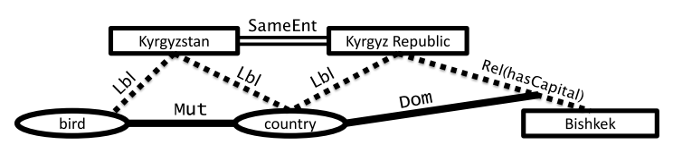
The process of inferring a knowledge graph from a noisy extraction graph is knowledge graph identification.

Slide 9
Background: PSL
Probabilistic soft logic (PSL) is a recently-introduced framework which allows users to specify rich probabilistic models over continuous-values random variables.
It uses first-order logic to describe features that define a Markov network.
In contrast to other approaches, PSL employs continuous-valued random variables rather than binary variables and casts most probable explanation (MPE) inference as a convex optimization problem.

Slide 10
Background: PSL
A PSL model is composed of a set of weighted, first-order logic rules, where each rule defines a set of features of a Morkov network sharing the same weight.
Here, w is the weight of the rule, A, B and C are universally-quantified variables, and P, Q and R are predicates.

Slide 11
Background: PSL
In this example, assigning constant values a, b, and c to the respective variables in the rule would produce the ground atoms P(a, b), Q(b, c), R(a, b, c). Each ground atom takes a soft-truth value in the range [0, 1].
PSL associates a numeric distance to satisfaction with each ground rule that determines the value of the corresponding feature in the Markov network.

Slide 12

Background: PSL
In particular, PSL uses the Lukasiewicz t-norm and co-norm to provide a relaxation of the logical connectives, AND (∧), OR (∨), and NOT.
The relaxations are denoted using the ~ symbol over the connective.

Slide 13
Knowledge Graph Identification
Knowledge graphs contain three types of facts
Facts about entities
Facts about entity labels
Facts about relations
Representation
Entities with the logical predicate: ENT(E)
Labels with the logical predicate: LBL(E, L)
Relations with the logical predicate: REL(E₁, E₂, R)
Goal
Identify a true set of atoms from a set of noisy extractions.

Slide 14
Knowledge Graph Identification
Methods
Capturing uncertain extractions
Perform entity resolution
Enforce ontological constraints

Slide 15
Knowledge Graph Identification

Slide 16
Represent Uncertain Extractions
For each candidate entity, they introduce a corresponding predicate, CANDENT(E). Labels or relations generated by the information extraction system correspond to predicates CANDLBL(E, L) or CANDREL(E₁, E₂, R).
Uncertainty in these extractions is captured by assigning these predicates a soft-truth value equal to the confidence value from the extractor.
For example, hasCapital(kyrgyzstan, Bishkek) with a confidence of 0.9, would be represented as CANDREL(kyrgyzstan, Bishkek, hasCapital) and assign it a truth value of 0.9.

Slide 17
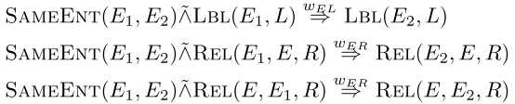
Entity Resolution
Use the SAMEENT predicate to capture the similarity of two entities, for example, SAMEENT(kyrgyzstan, kyrgz republic).
To perform entity resolution, they introduce 3 rules
When two entities are very similar, they will have a high truth value for SAMEENT.

Slide 18
Enforce ontological constraints
Each type of ontological relation is represented as a predicate, and these predicates represent ontological knowledge of the relationships between labels and relations.
For example, the ontological predicates DOM(hasCapital, country) and RNG(hasCapital, city) specify that the relation hasCapital is a mapping from entities with label country to entities with label city.
The predicate MUT(country, city) specifies that the labels country and city are mutually exclusive.

Slide 19
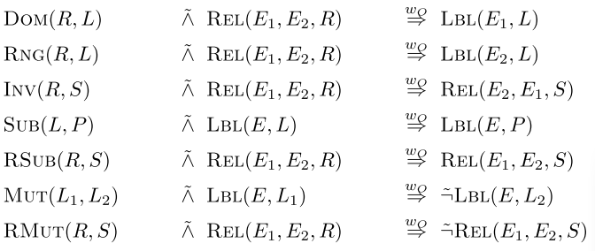
Seven types of ontological constraints using weighted rules

Slide 20

Probability Distribution over Uncertain Knowledge Graphs
They can define a PSL program Π:
A set of ground rules R
Uncertain candidates C
Co-referent entities S
Ontological relationships O
The distribution over interpretations Ι, generated by PSL corresponds to a probability distribution over knowledge graphs G:

Slide 21
Probability Distribution over Uncertain Knowledge Graphs
The results of inference provide us with the most likely interpretation, or soft-truth assignments to entities, labels and relations that comprise the knowledge graph.
By choosing a threshold on the soft-truth values in the interpretation, we can select a high-precision set of facts to construct a knowledge graph.

Slide 22
Experimental evaluation

Slide 23
Datasets and experimental setup
Datasets
Synthetic knowledge base that derived from LinkedBrainz project
Maps the data from the MusicBrainz community using ontological information from the MusicOntology.
Web-extraction data from NELL
Experimental setup
Limited to a subset of the knowledge graph from the test or query set.
Inference produces a complete knowledge graph

Slide 24
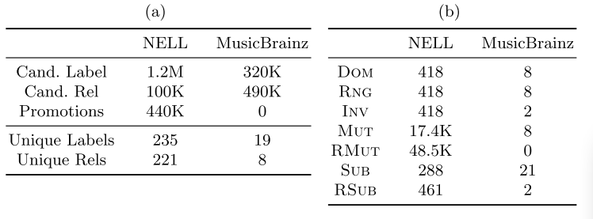
Dataset statistics for NELL and MusicBrainz

Slide 25
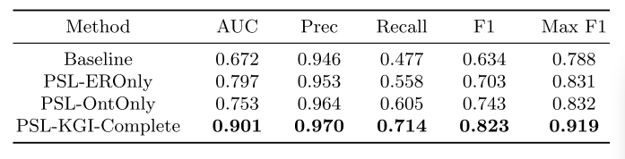
Comparison results on MusicOntology

Slide 26
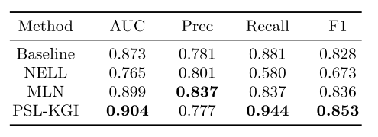
Comparing against previous NELL work

Slide 27
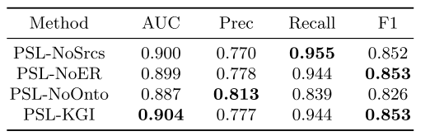
Comparing variants of PSL

Slide 28
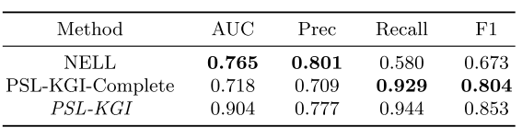
Producing a complete graph
Scalability: Inference when an explicit query set of 70K facts is given (PSL-KGI) requires a mere 10 seconds. To produce the complete knowledge graph containing 4.9M facts, PSL-KGI uses 130 minutes.

Slide 29
Summary
Knowledge Graph identification can jointly infer a knowledge graph from the noisy output of an information extracting system.
Future work
Apply KGI to larger, more varied problems with richer ontological relationships.

Slide 30
Lessons
Biomedical ontology identification and integration
Extract useful knowledge from the noisy data extracted using natural language processing, such as TCM, or biomedical data

Slide 31
Thanks

